Slide 1
Adulting 101
Credit vs Debit
College Prep
Mr. Gordon
jgordon@bisdtx.org

Slide 2
Upcoming Events

Slide 3
Adulting 101-Credit vs Debit
Debit cards are tied directly to your checking account.
You can only spend as much as you have in the bank.
Example: If you have $2,000 in your bank account, you will not be able to purchase a tv for $2,500.
This is good because you do not have to pay interest and cannot over purchase.
Debit cards have no impact on your credit score.
Debit cards offer no rewards or incentives for spending.
These are best for day-to-day purchases.

Slide 4
Adulting 101-Credit vs Debit
Credit cards charge an interest rate on purchases if not paid on time.
Average interest rate is around 20%.
Many people carry large balances and only pay the minimum amount, instead of the full balance. This will end up costing you a lot in the end.
You need to make the full payment every month.
If used wisely, credit cards can be beneficial. See next slide.

Slide 5
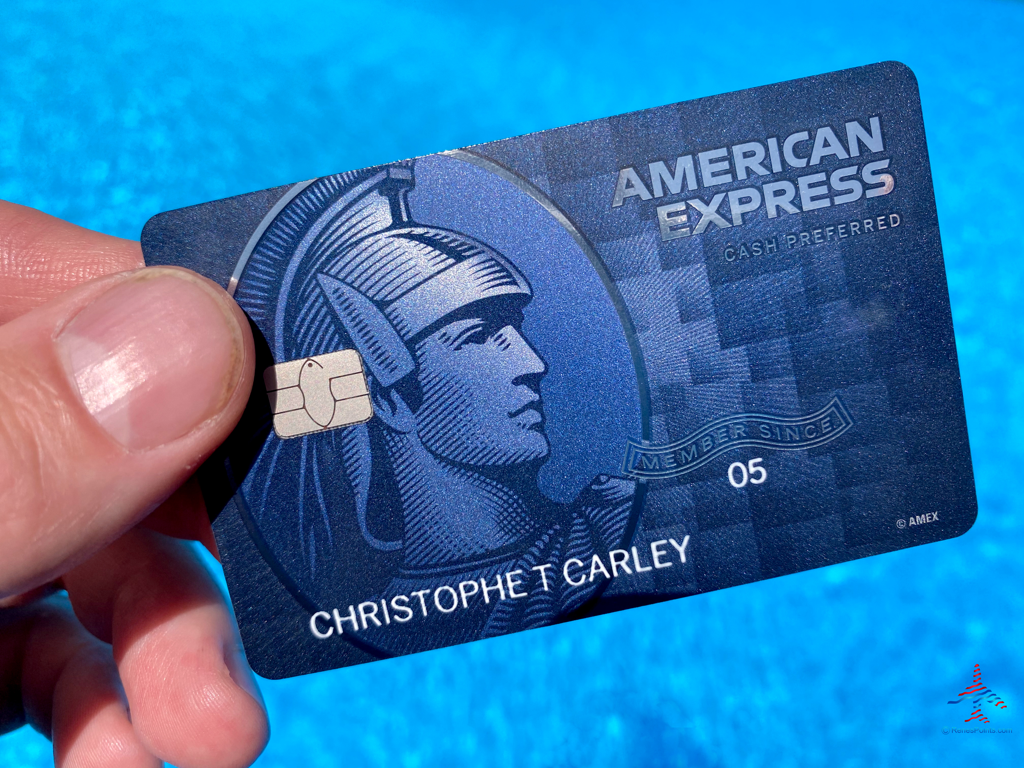
Adulting 101-Credit vs Debit
Credit cards impact your credit score and usually offer incentives for spending, such as travel or cash back.
These are the two credit cards I currently have. I did not have a credit card until my 30’s but this is highly unusual.
American Express Blue Card 6% back on groceries
Amazon Store Card 5% back on purchases

